Slide 1

Airline Reservation system
Mahakal Institute of Technology
Department of Information Technology
Internal Presentation On
Presented By:-
Sanket Gupta
0704IT151029
Chintan Atre
0704IT151009
Smita Vishwakarma
0704IT151035
Project Guide:-
Prof. Neha Agarwal

Slide 2
Abstract
This project is used at different reservation agency to reserve seats for the passengers online. The System is an attempt to integrate the services offered by the different airlines and companies across the world. It proposes to make the process of flight reservation, Internet based, where the different airlines will have a common single platform for reservation of seats into their flights.

Slide 3
content
PROBLEM STATEMENT
NEEDS OF AIRLINE SYSTEM
TECHNOLOGY USED
ANALYSIS OVERVIEW
ACTIVITY OVERVIEW
DESIGN OVERVIEW
SEQUENCE DIAGRAM
LIMITATION
CONCLUSION
REFERENCE

Slide 4
Problem statement
The definition of our problem lies in manual system and a fully automated system.
Manual system: The system is very time consuming and lazy. This system is more prone to errors and sometimes the approach to various problems are unstructured.
Technical system: With the advent of latest technology if we do not update our system then our business results in losses gradually with time. The technical systems contains the tools of latest trend i.e. computers printers, fax, Internet etc. The systems with this technology are very fast, accurate, user-friendly and reliable.

Slide 5
Need of Airlines system
A few factors that direct us to develop a new system are given below -:
1) Faster System
2) Accuracy
3) Reliability
4) Reservations and cancellations from anywhere to any place.

Slide 6


Technology used
HTML 5 & CSS 3
BOOTSTRAP 4
JAVA server page

Slide 7
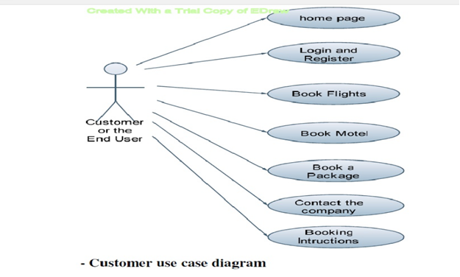
ANALYSIS overview

Slide 8
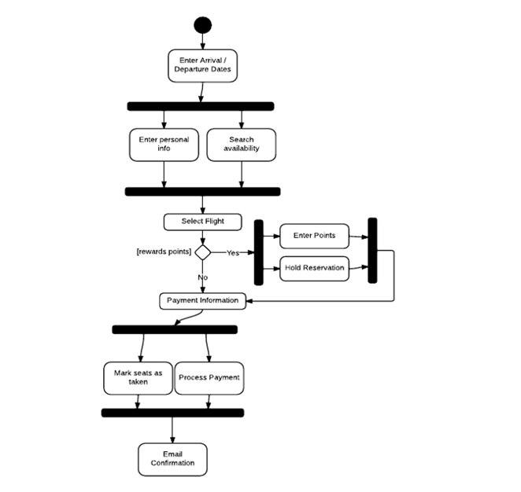
Activity diagram

Slide 9
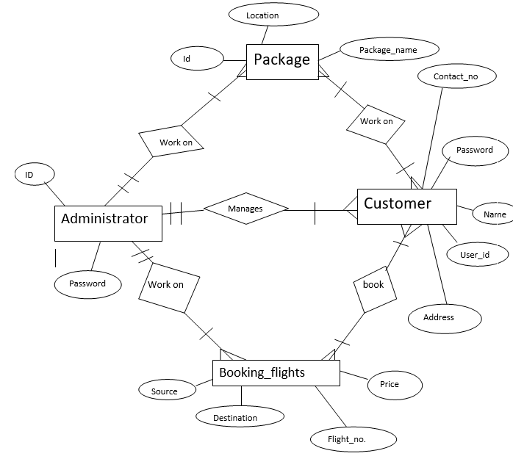
Design Overview

Slide 10
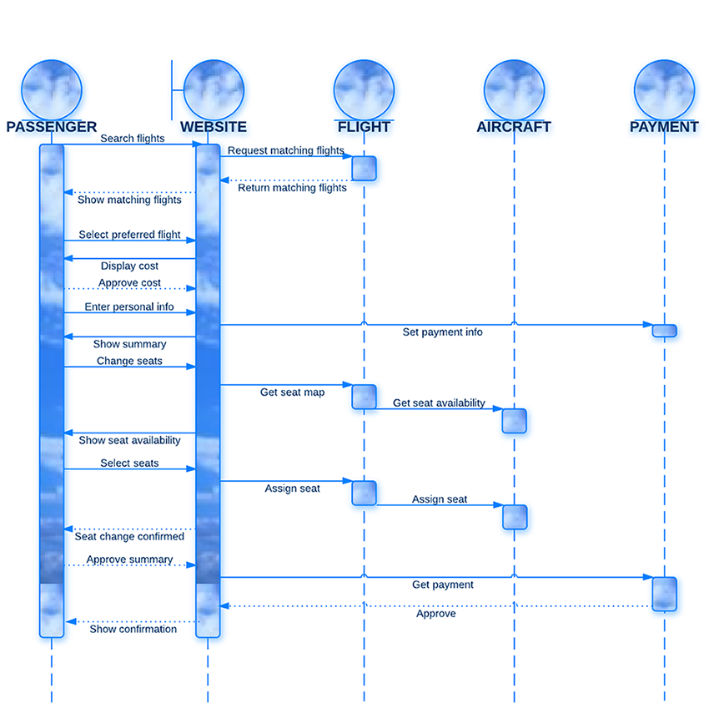
SEQUENCE DIAGRAM

Slide 11
LimitationS
No Information on the delay of aero planes to passengers.
Slow respond about refunding.
Low quality customer services.
High registration and service charge.
Toll free is not available for customer enquiries.
They increased the ticket fares during festival time public holidays.

Slide 12
Conclusion
In this project, we aim to deliver a website which enable user to book airline ticket without going to other websites and wandering around.

Slide 13
References
Various sites referred to during making of the project are as follows:
www.en.wikipedia.org
www.google.com
www.howstuffworks.com
www.roseindia.net
www.w3cschools.com

Slide 14
THANK YOU

